Slide 1
Peer-graded Assignment: Capstone Project – The Battle of Neighborhoods by Mohammed Burhanuddeen R , Github account [@Metallurgist]

Slide 2
A new location to start Coffee shop in Manhattan, New York City

Slide 3
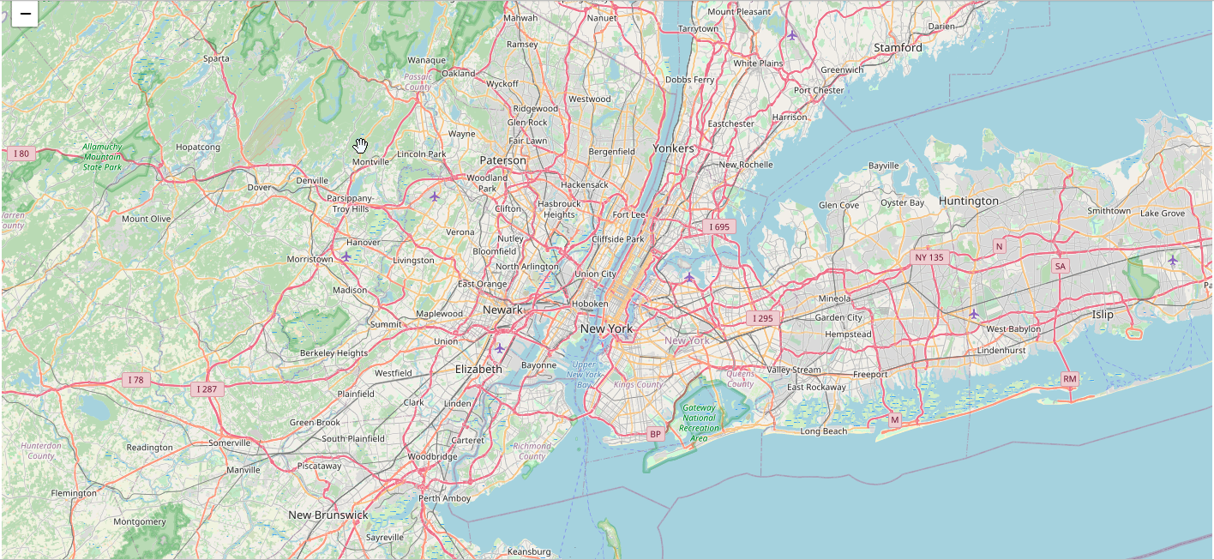
Introduction
New York City
S.No | Borough | Population ( 2019 estimate ) | Population Density ( person/sq.mi )
1 | Manhattan | 1,628,706 | 71,341
2 | Brooklyn | 2,559,903 | 36,147
3 | Queens | 2,253,858 | 20,767
4 | Bronx | 1,418,207 | 33,867
5 | Staten Island | 476,143 | 8,157

Slide 4
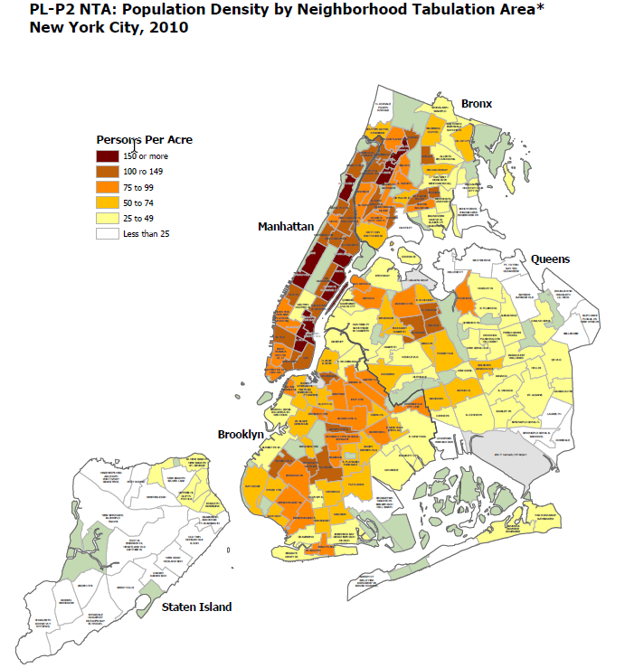
Borough | Population ( 2019 estimate ) | Population Density ( person/sq.mi )
Manhattan | 1,628,706 | 71,341

Slide 5
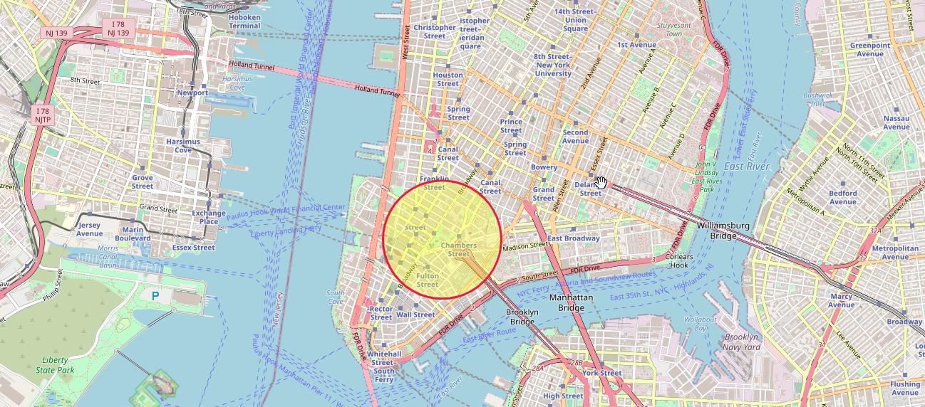
Area of Interest (AOI)
With a starting geo point of [ 40.7127281,-74.0060152 ], the search radius of 600 is set as our initial Area of Interest AOI-1.

Slide 6
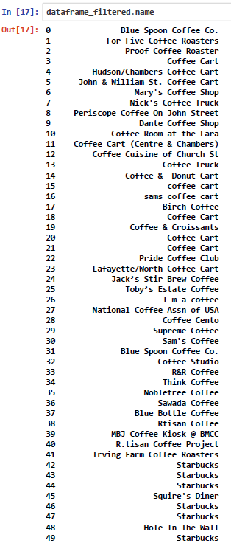
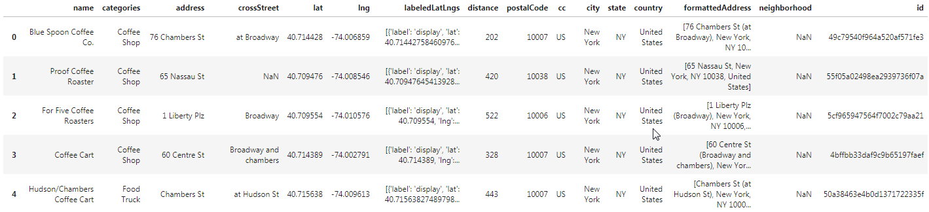
List of nearby Coffee venues

Slide 7
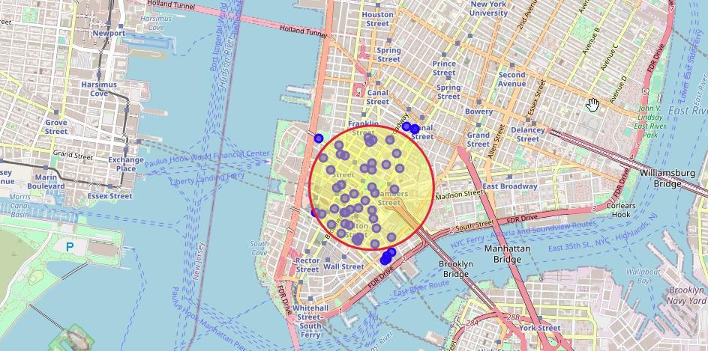
Analysis
Mapping the Coffee venues search results within AOI-1:

Slide 8
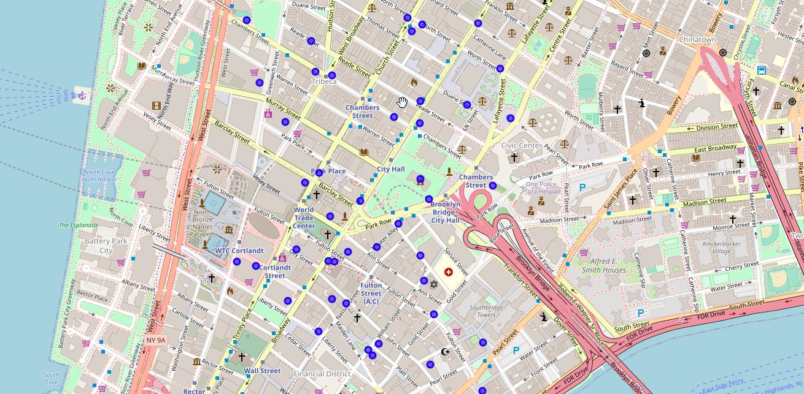
Analysis
Exploring Venues

Slide 9
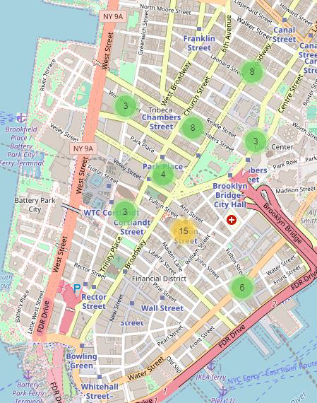
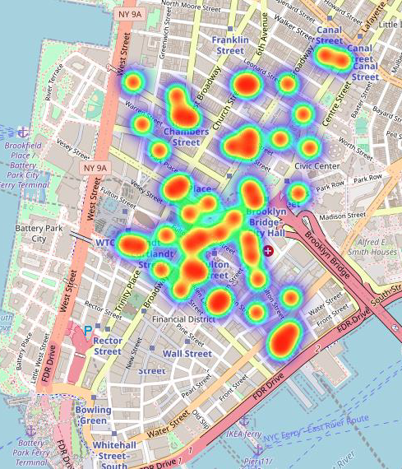
Analysis
Clustering Heat map

Slide 10
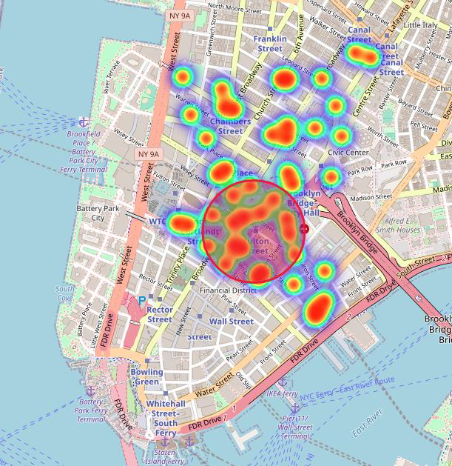
Analysis
Creating a new AOI-2 based on Heat map

Slide 11
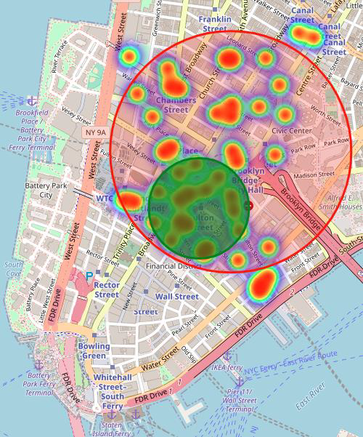
Results
Superimposing both AOI's (AOI-1 and AOI-2):

Slide 12
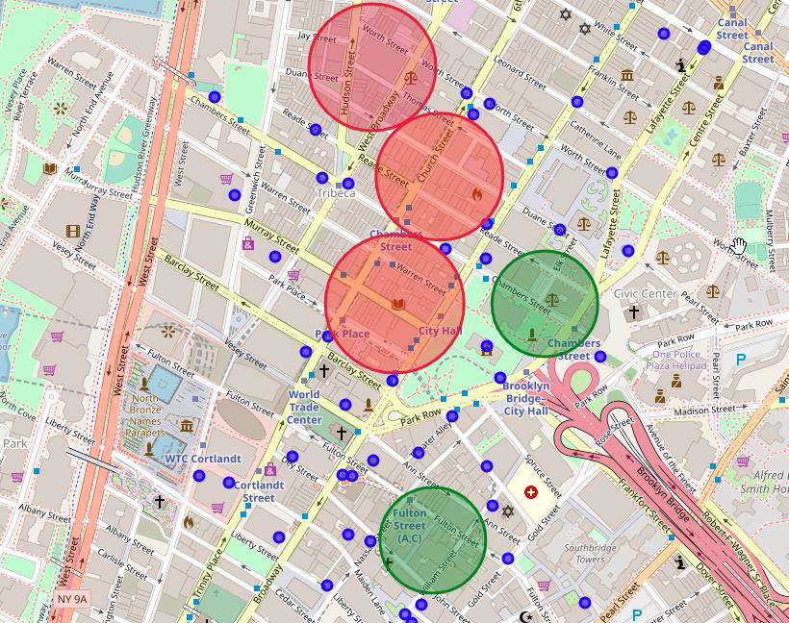
Discussion
Which venue to choose for the business??

Slide 13
Conclusion
The client can choose the proposed locations in green circles and also venues along the main roads connecting Park Row, Brooklyn and Chambers Street. This analysis excludes parameters such as venue cost, availability and other investment costs.

Slide 14
THANKS !!

